Slide 1
COMPARISON OF VARIOUS PREDICTION METHODS FOR RENEWABLE ENERGY (SOLAR & WIND)
Group - 09
MAJOR PROJECT
Under Dr. Bhinal Mehta
Divyatej Mishra – 19BEE023
Prachi Kanakhara – 19BEE052

Slide 2

TABLE OF CONTENT
WIND ENERGY
SOLAR ENERGY
03
04
METHODOLOGY
FUTURE PROSPECTS
02
05
INTRODUCTION
01
06
CONCLUSION

Slide 3
1. INTRODUCTION
MOTIVATION
SCOPE
PROBLEM
IDENTIFICATION

Slide 4
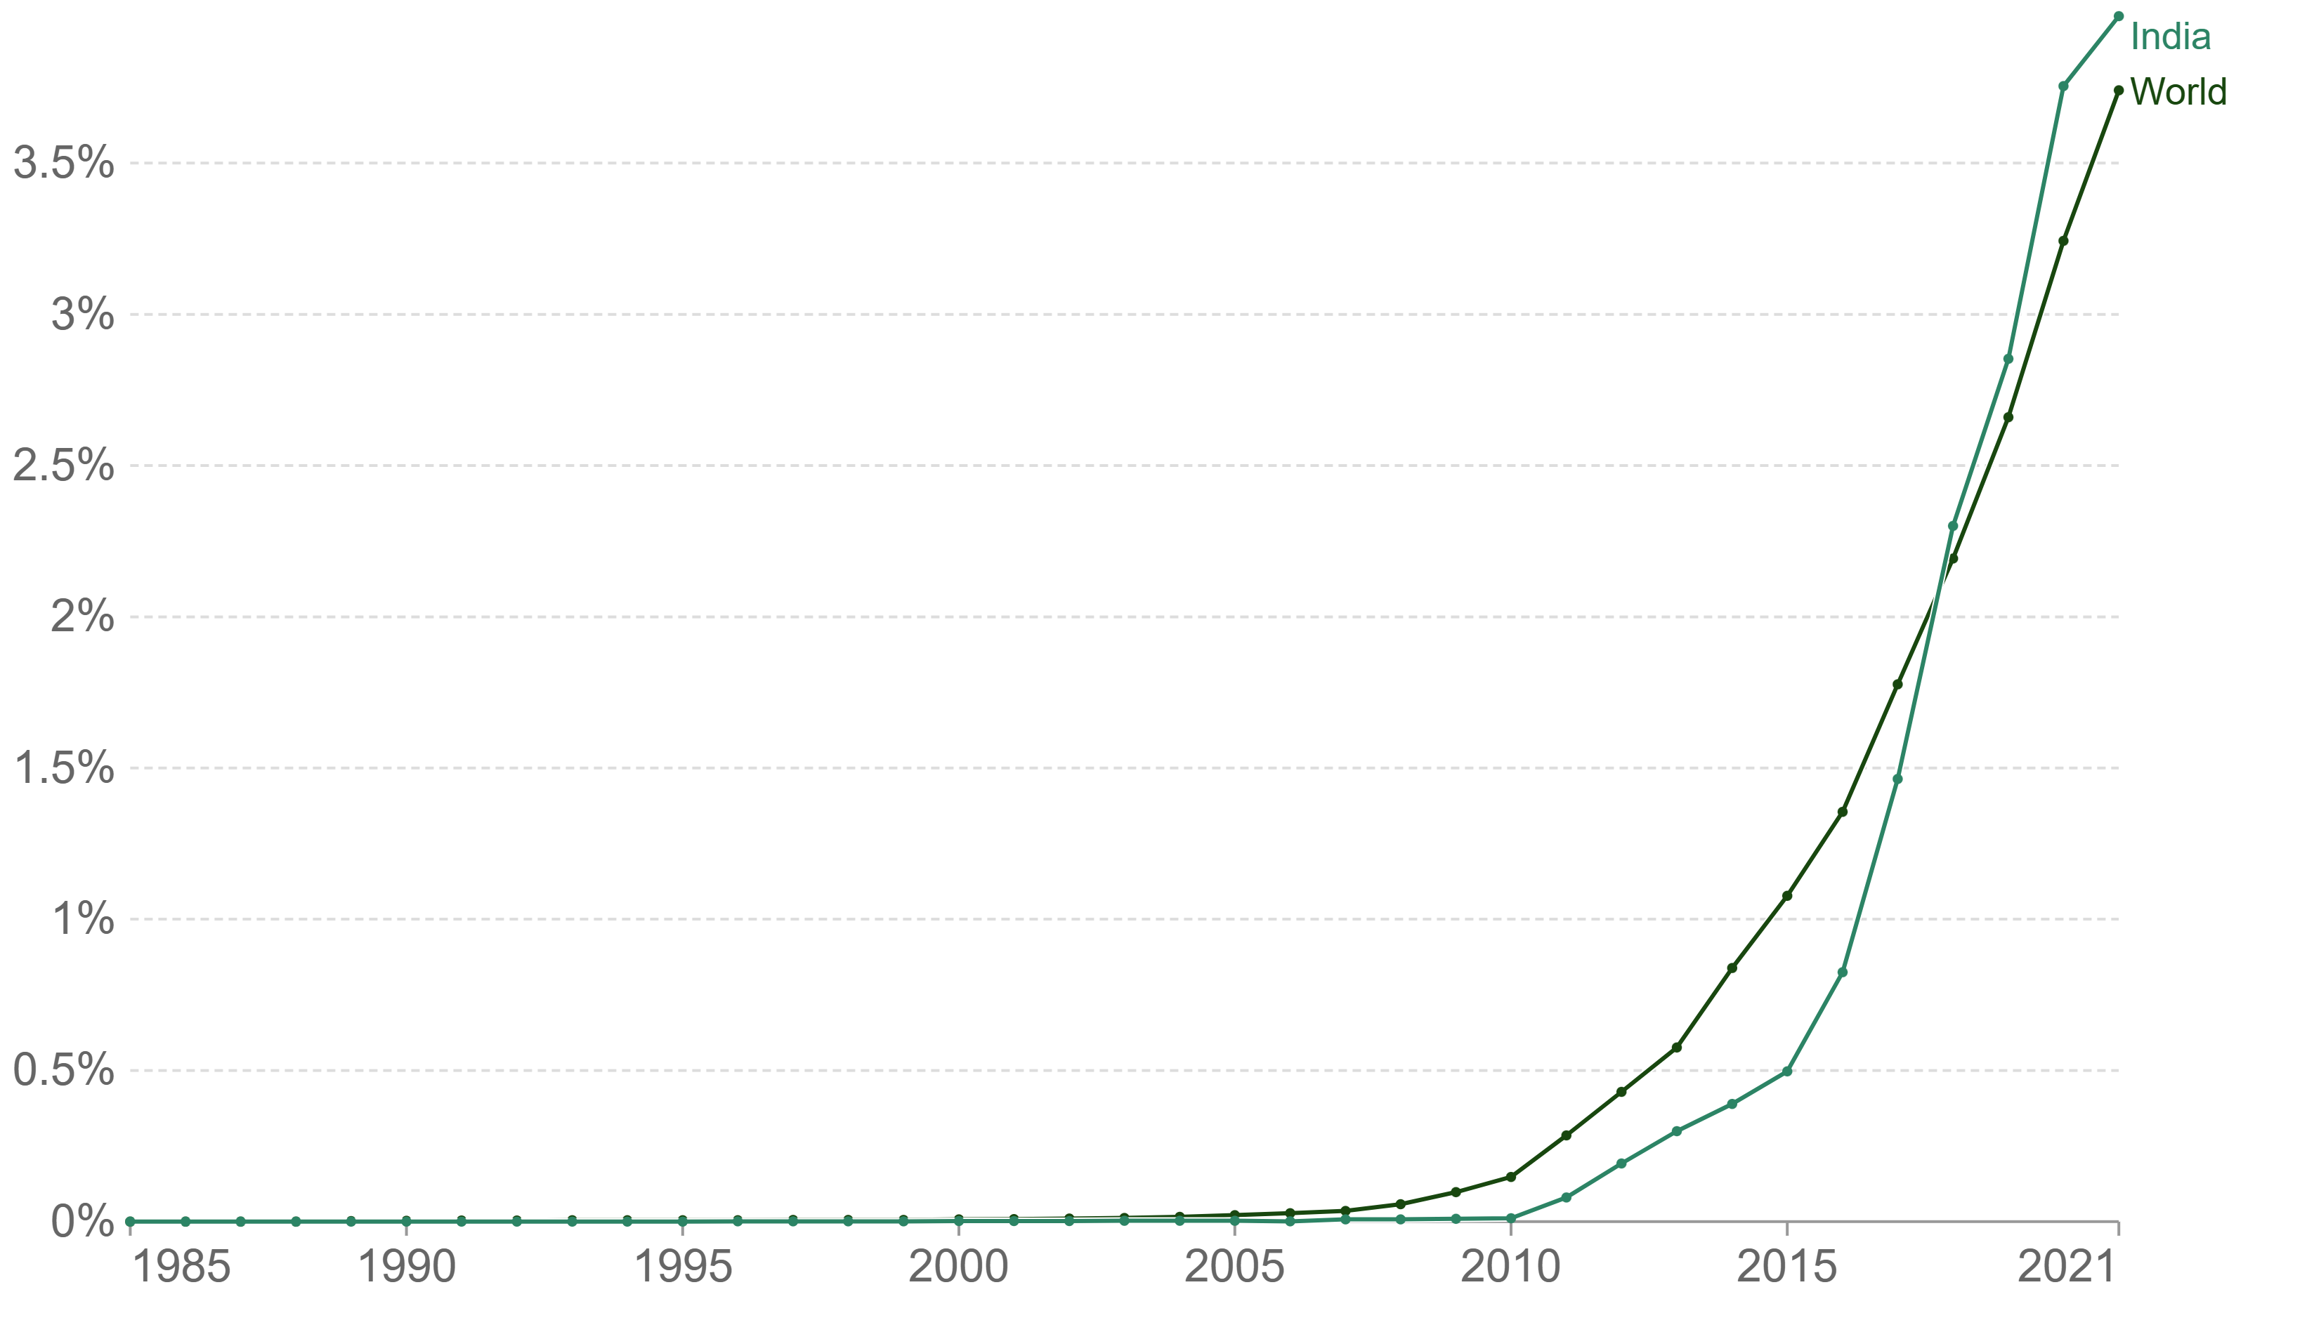
MOTIVATION
Share of Electricity Production From Solar Energy

Slide 5
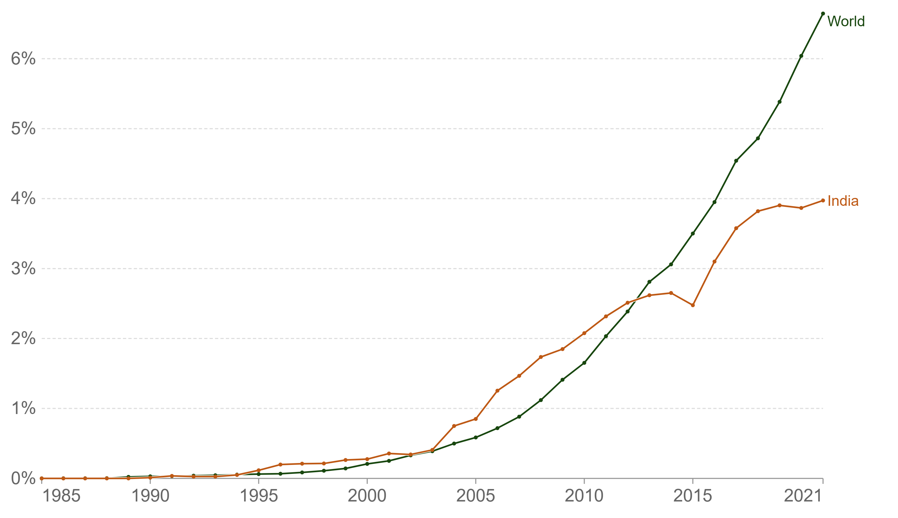
Share of Electricity Production From Wind Energy

Slide 6
SCOPE
REVIEW & ANALYSE
ML TECHNIQUES
COMPARE
CO2 EMISSION
DEPENDENCY ON FOSSIL FUEL
PROBLEM IDENTIFICATION

Slide 7
2. METHODOLOGY
SUPERVISED
RESEARCH METHOD | QUANTITATIVE
SOURCES | SECONDARY
RESEARCH DESIGN | COMPARATIVE
TYPES
UNSUPERVISED
REINFORCEMENT
DATA COLLECTION
DATA PREPROCESSING
TRAINING MODEL
EVALUATE MODEL
IMPROVE

Slide 8
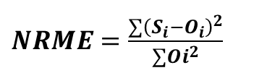
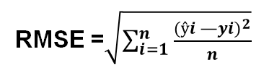


ERROR MEASUREMENT
MSE
NRMSE
$NRME=\frac{∑{\left(S_{i}−O_{i}\right)}^{2}}{∑{Oi}^{2}}$
$$MSE=\frac{1}{n}\sum_{i=1}^{n}{{\left(Y_{i}−{\hat{Y}}_{1}\right)}^{2}}$$
MAPE
RMSE
$M=\frac{1}{n}\sum_{t=1}^{n}{\left|\frac{A_{t}−F_{t}}{A_{t}}\right|}$
RMSE =$\sqrt{\sum_{i=1}^{n}{\frac{{(ŷi —yi)}^{2}}{n}}}$

Slide 9
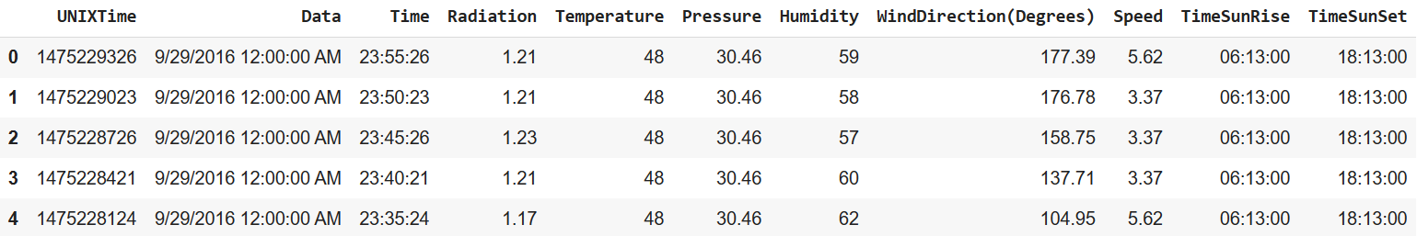
PARAMETERS
DATA DESCRIPTION

Slide 10
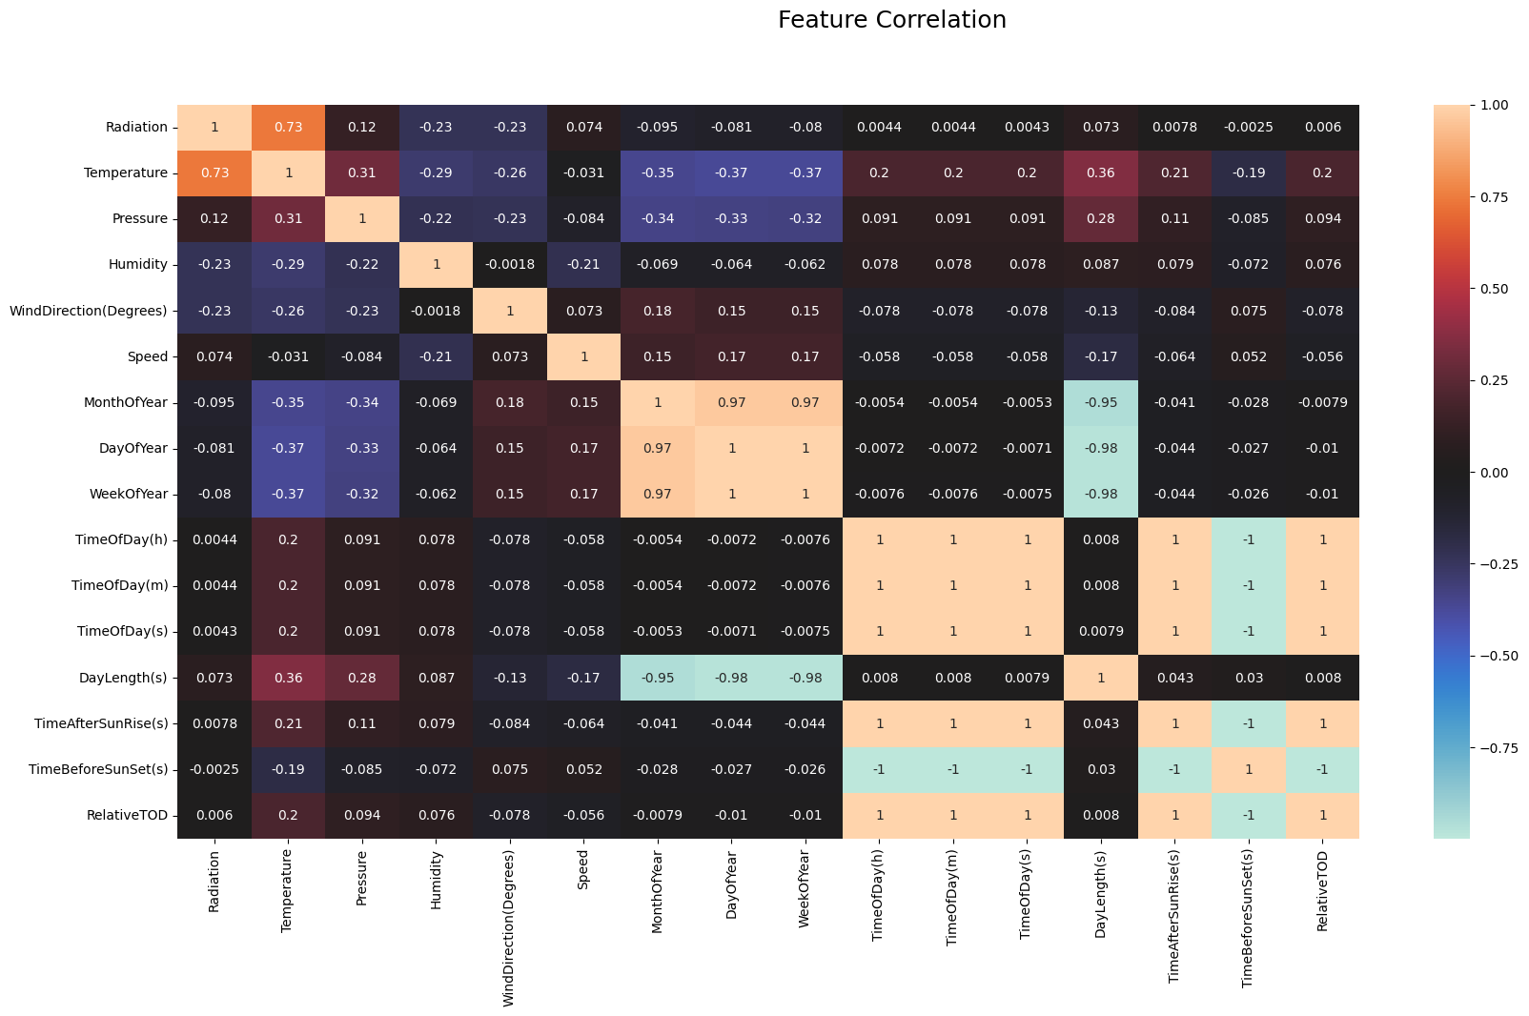

Slide 11
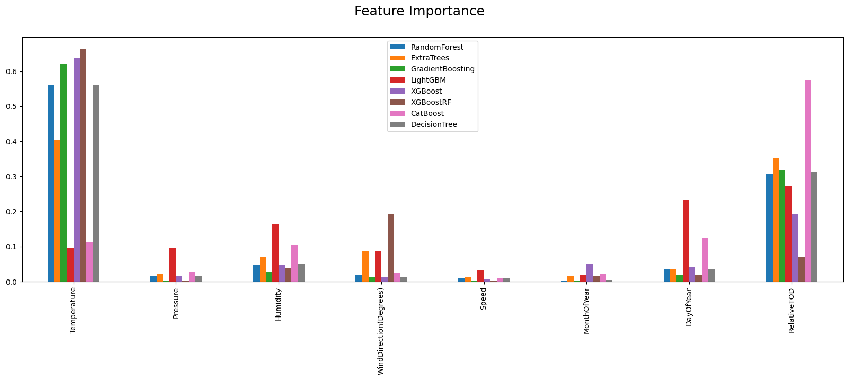

Slide 12
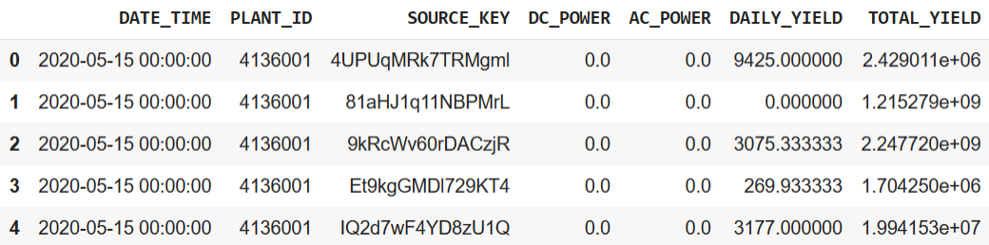
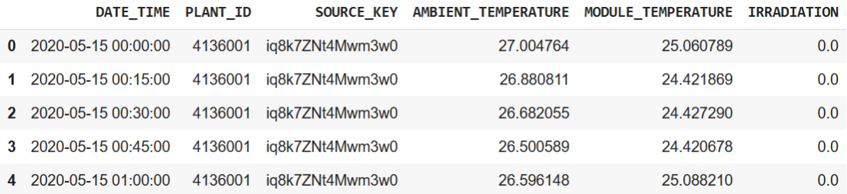
3. SOLAR
DATA DESCRIPTION
GENERATION DATA
WEATHER DATA

Slide 13
ALGORITHMS AND TECHNIQUES
RANDOM FOREST
DECISION TREE REGRESSOR
LASSO REGRESSOR
RIDGE REGRESSOR
LINEAR REGRESSION

Slide 14

LINEAR REGRESSION

Slide 15
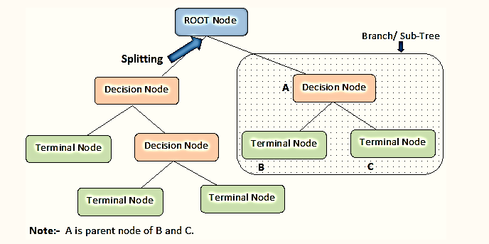
DECISION TREE REGRESSOR

Slide 16
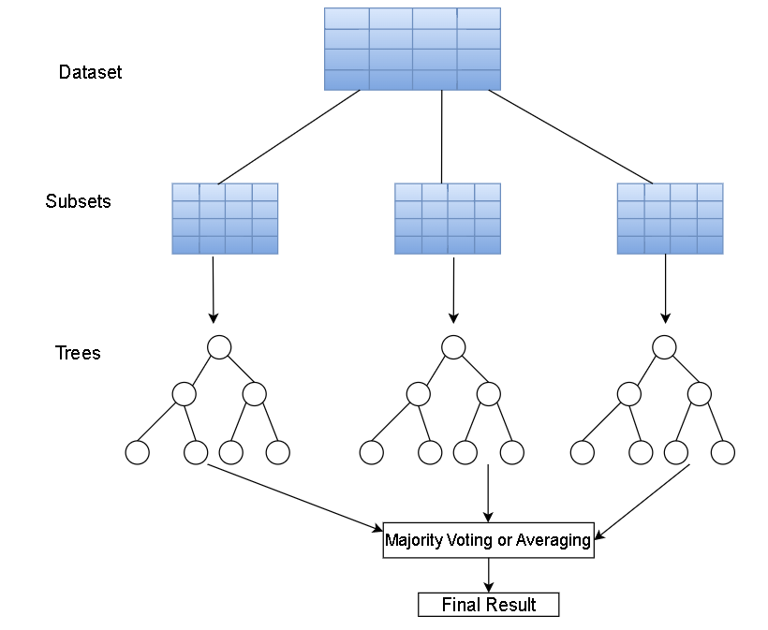
RANDOM FOREST

Slide 17
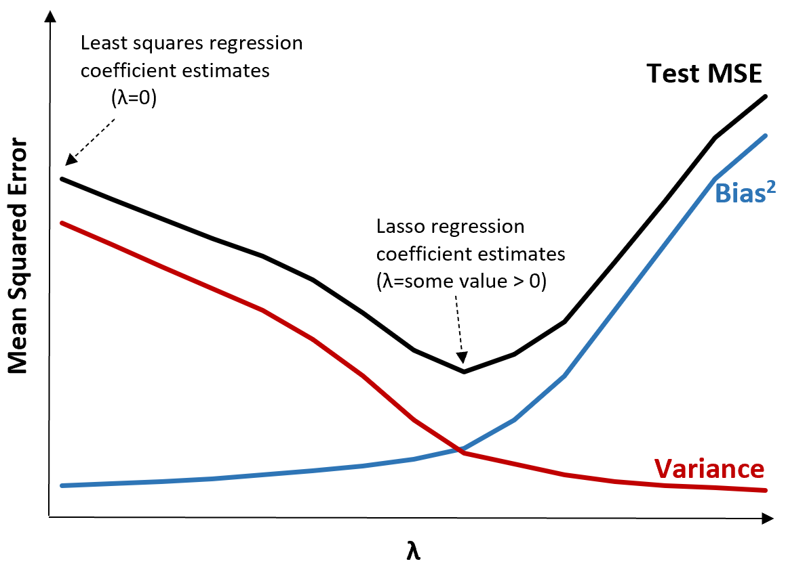
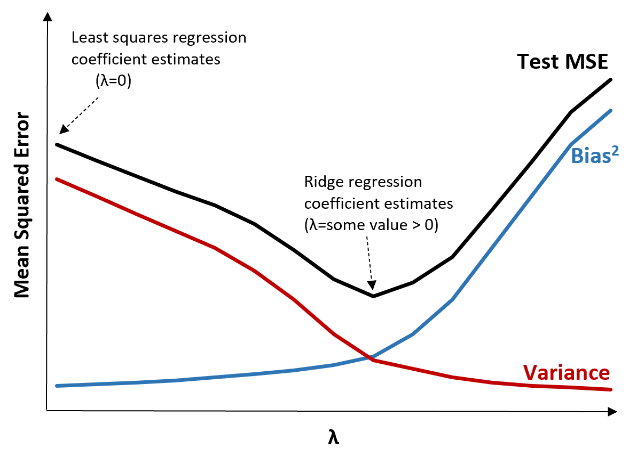
LASSO REGRESSION
RIDGE REGRESSION

Slide 18
COMPARISON AND RESULTS
SOLAR ENERGY ERROR COMPARISON
TECHNIQUE | MEAN VALIDATION RMSE (%)
LINEAR REGRESSION | 2.4302998881730917
DECISION TREE REGRESSOR | 2.3328394586081282
RANDOM FOREST REGRESSOR | 1.757966671219207
RIDGE REGRESSOR | 2.43388927538925
LASSO REGRESSOR | 2.8508597011572148

Slide 19
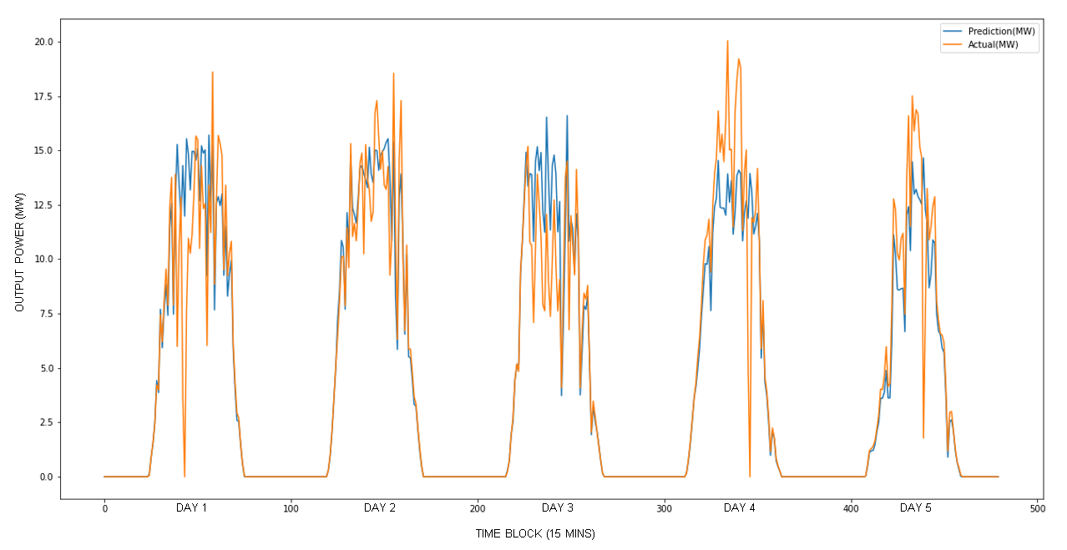
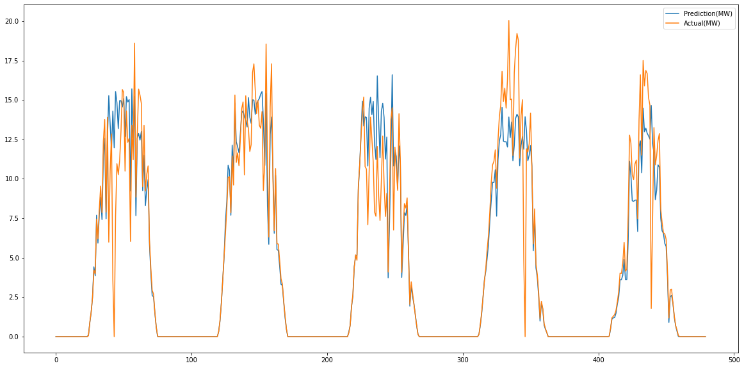
SOLAR ENERGY OUTPUT
OUTPUT POWER (MW)
DAY 1
DAY 2
DAY 3
DAY 4
DAY 5
TIME BLOCK (15 MINS)

Slide 20
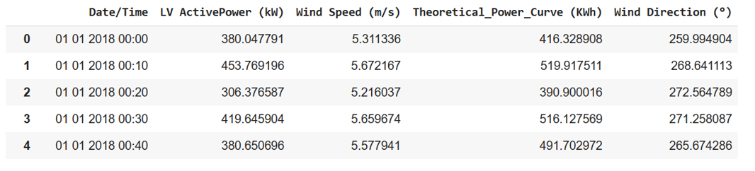
4. WIND
DATA DESCRIPTION
GENERATION DATA

Slide 21
ALGORITHMS AND TECHNIQUES
RANDOM FOREST
DECISION TREE REGRESSOR
GRADIENT BOOSTING REGRESSOR
EXTRA TREE REGRESSOR
KNN

Slide 22
DECISION TREE REGRESSOR

Slide 23
RANDOM FOREST

Slide 24
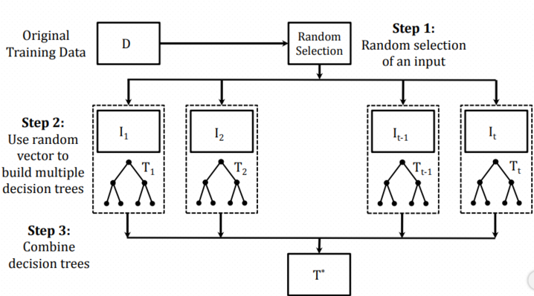
EXTRA TREE REGRESSOR

Slide 25
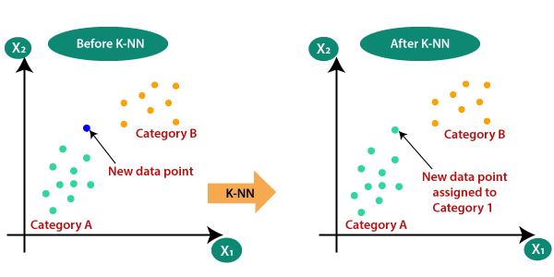
KNN

Slide 26
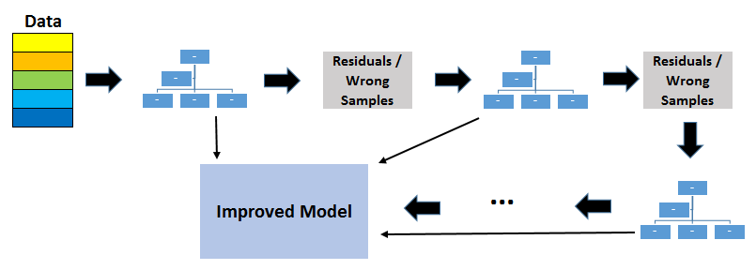
GRADIENT BOOSTING REGRESSOR

Slide 27
COMPARISON AND RESULTS
WIND ENERGY ERROR COMPARISON
TECHNIQUE | MEAN VALIDATION RMSE (%)
KNN | 1.27622976983972
DECISION TREE REGRESSOR | 1.4963184284627
EXTRA TREES REGRESSOR | 1.2205605621235
RANDOM FOREST REGRESSOR | 1.1624225595648
GRADIENT BOOSTING REGRESSOR | 1.1476226247425

Slide 28
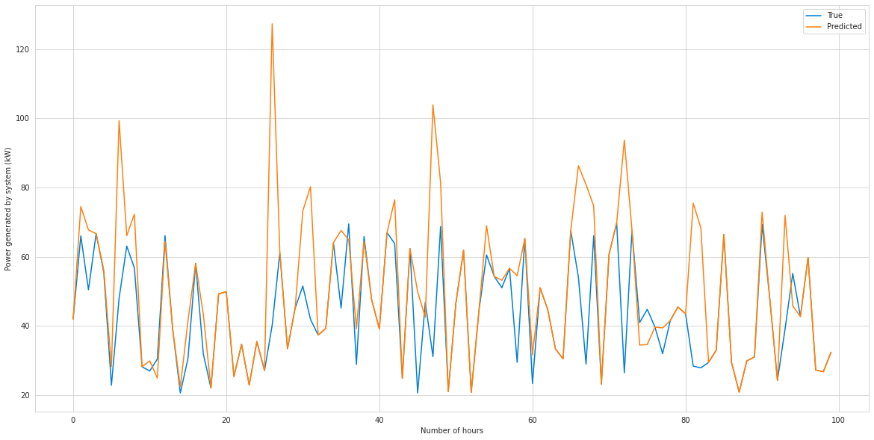
WIND ENERGY OUTPUT

Slide 29
5. FUTURE PROSPECTS
Standardization and Benchmarking
Industry Standardization
2
4
1
3
5
Big Data
Prediction for DERs
Scalability and Adaptability

Slide 30



6. CONCLUSION
REDUCE GHG
EMISSION
COST SAVING
BETTER MANAGEMENT
OPTIMIZED USE OF RENEWABE ENERGY

Slide 31
REFERENCES
Budu, E., & Budu, E. (2023). Random Forest vs. Extremely Randomized Trees | Baeldung on Computer Science. Baeldung on Computer Science. https://www.baeldung.com/cs/random-forest-vs-extremely-randomized-treeshttps://www.javatpoint.com/linear-regression-in-machine-learning
Chauhan, N. S. (n.d.). Decision Tree Algorithm, Explained - KDnuggets. https://www.kdnuggets.com/2020/01/decision-tree-algorithm-explained.htmlhttps://towardsdatascience.com/what-is-machine-learning-a-short-note-on-supervised-unsupervised-semi-supervised-and-aed1573ae9bb
K-Nearest Neighbor(KNN) Algorithm for Machine Learning - Javatpoint. (n.d.). www.javatpoint.com. https://www.javatpoint.com/k-nearest-neighbor-algorithm-for-machine-learning
Our World in Data. (n.d.-b). Our World in Data. https://ourworldindata.org/

Slide 32

THANK YOU

